Slide 1
Tableau first practice
File created on: 3/28/22 12:27:58 PM EDT

Slide 2


Slide 3
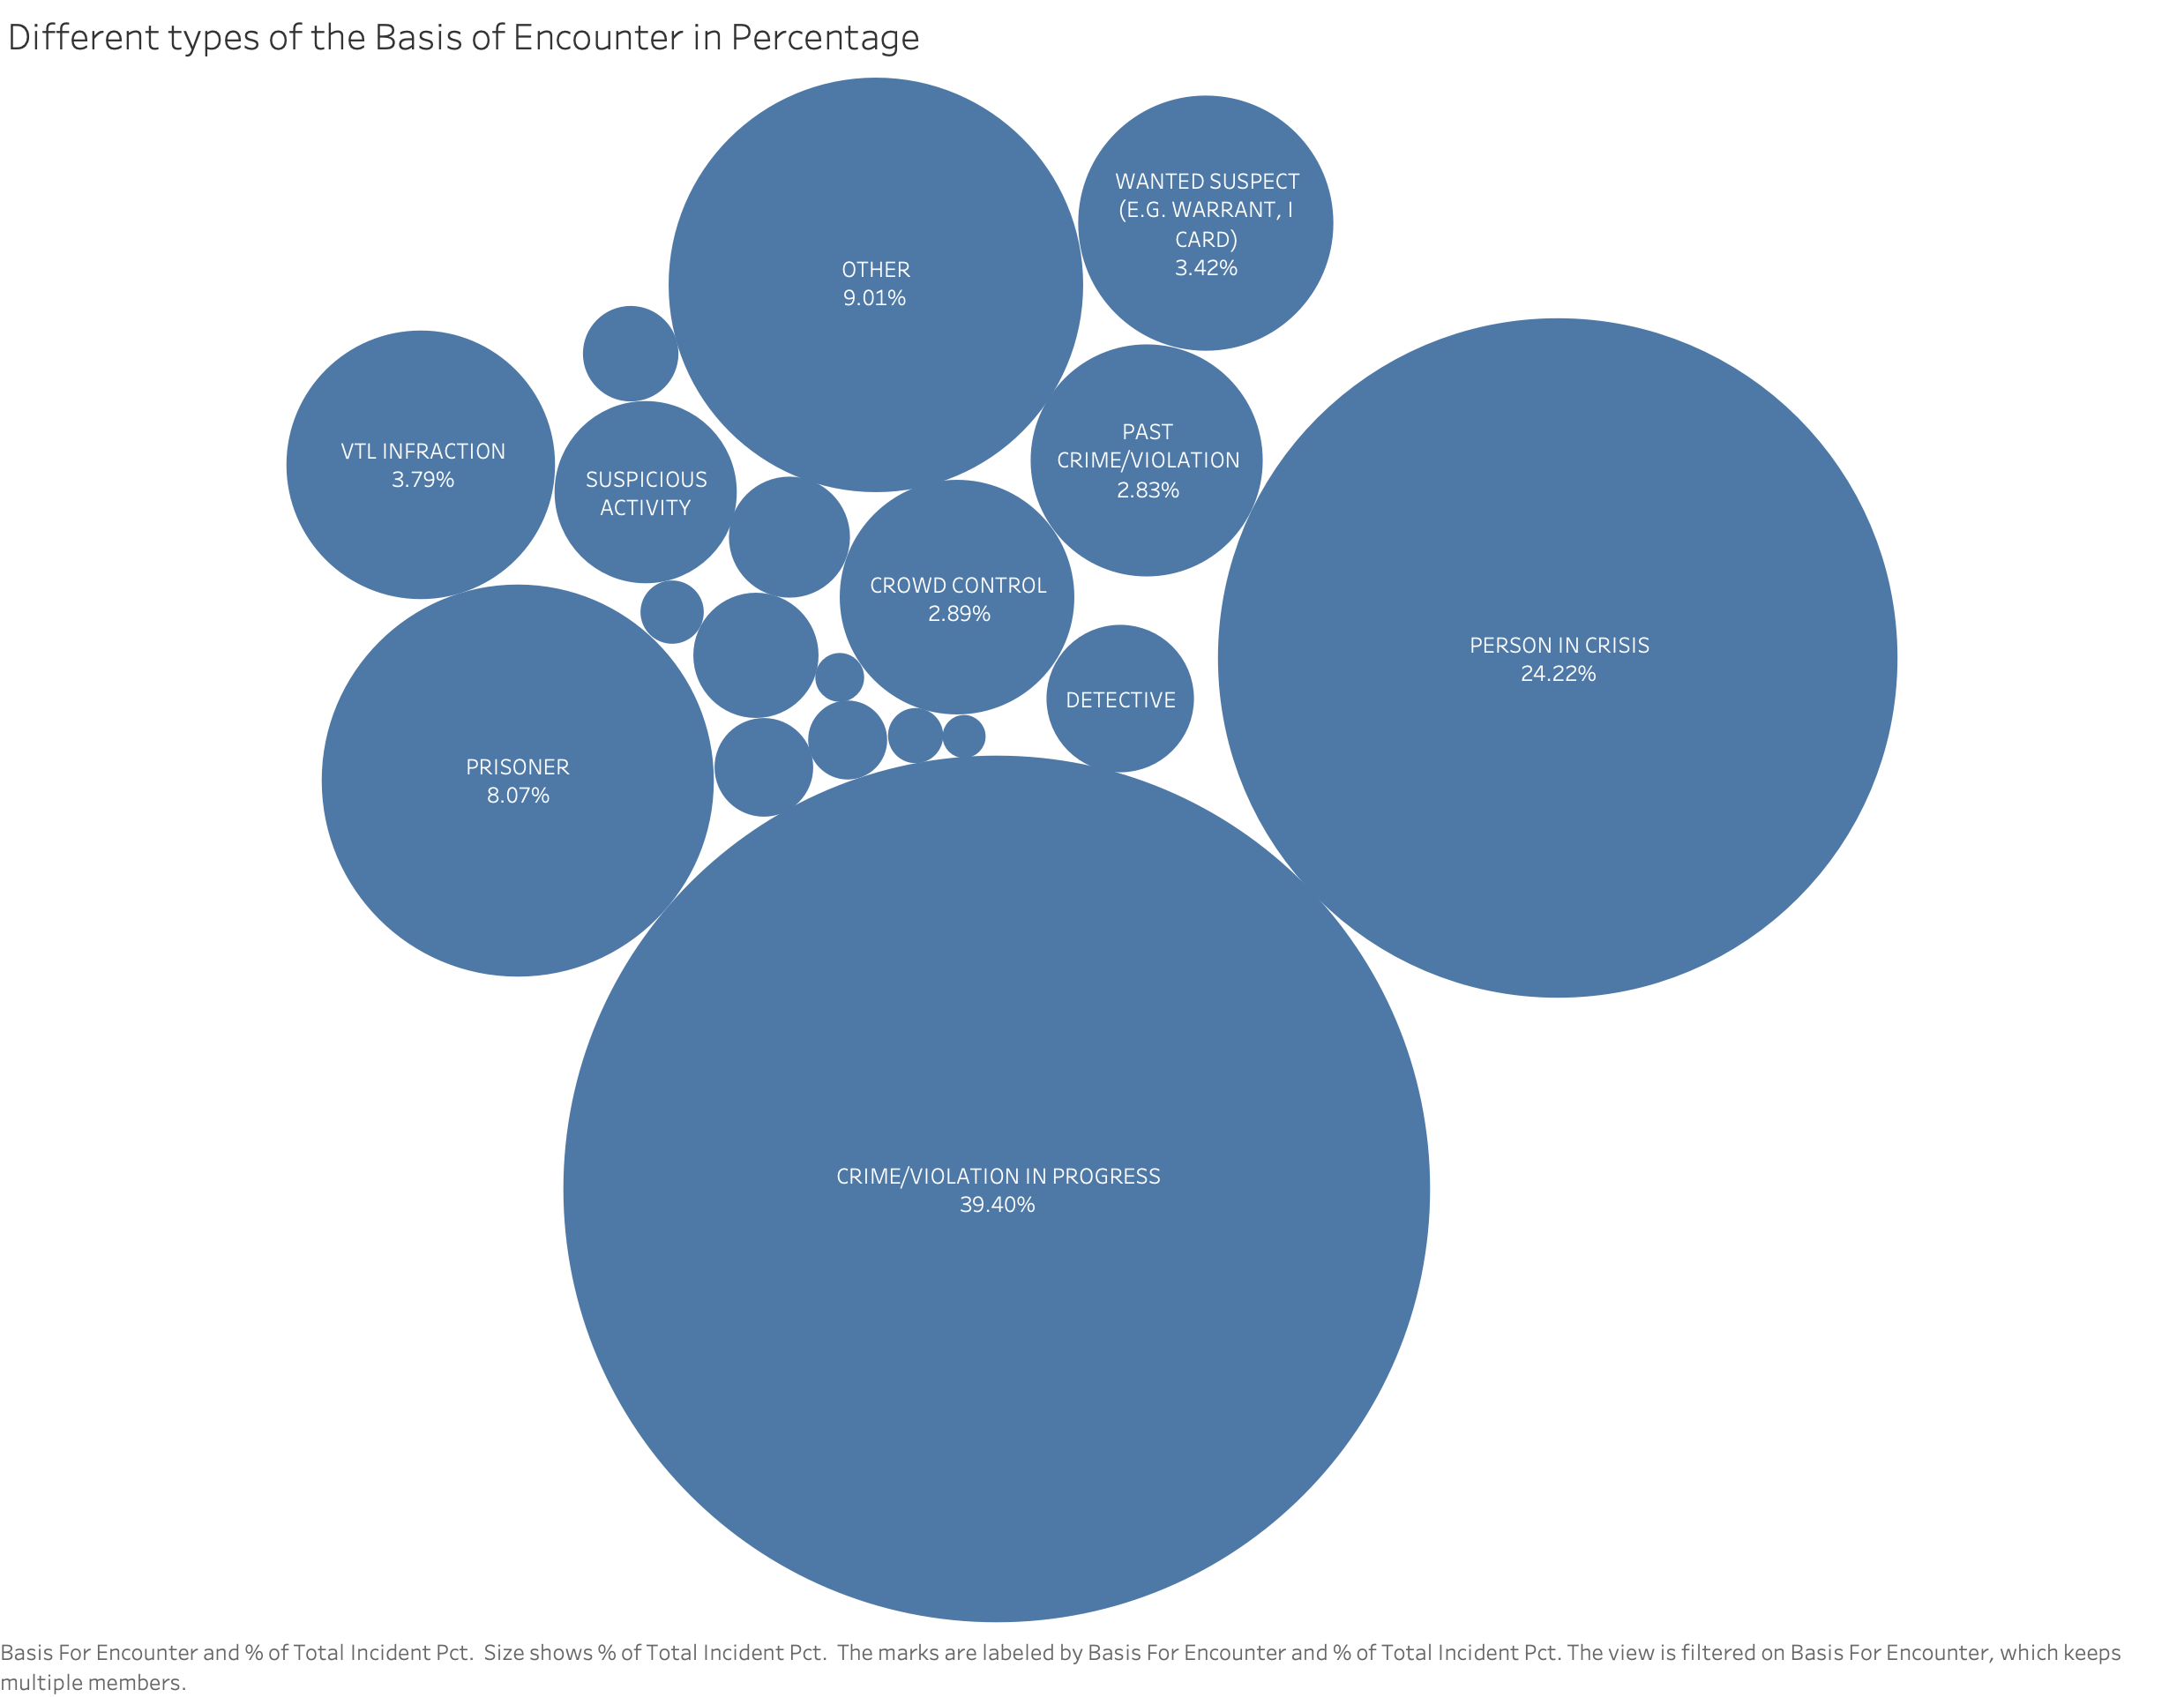

Slide 4
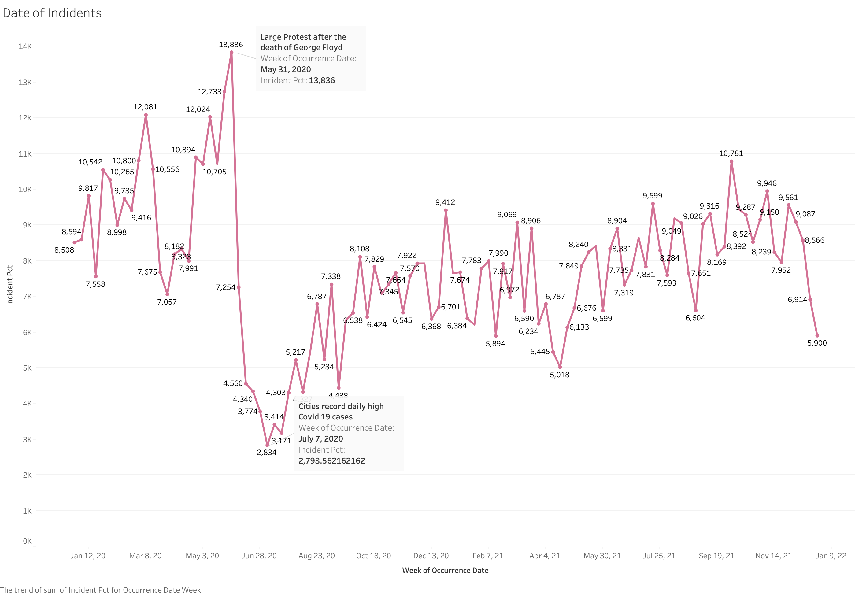

Slide 5
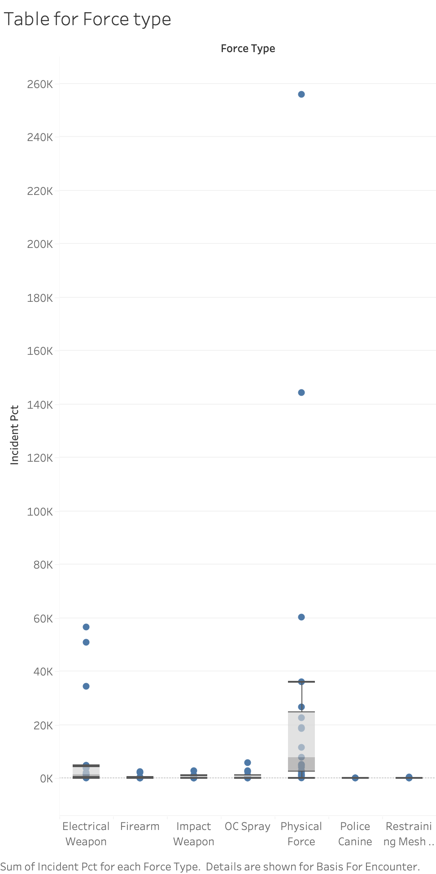

Slide 6
